Slide 1
BIG Fits for Small Data
Mixing group and individual data to improve model selection
Steven Riley, 8/25/17
Notes:
Technique for small data sets
Optimally blending group and individual data to improve prediction

Slide 2
Outline
Motivation for BIG (Blended Individual and Group) fits
Example and origins in 1-D data
Why it works
Extensions
Multivariate data
Model selection
Simulation experiment
Comparison of BIG with OLS
Notes:
-I call this technique BIG (blending individuals and groups)
-Due to time constraints, this talk will be light on detail
-If you have lingering questions that aren’t answered, please come find me
-Organization of the talk is …

Slide 3
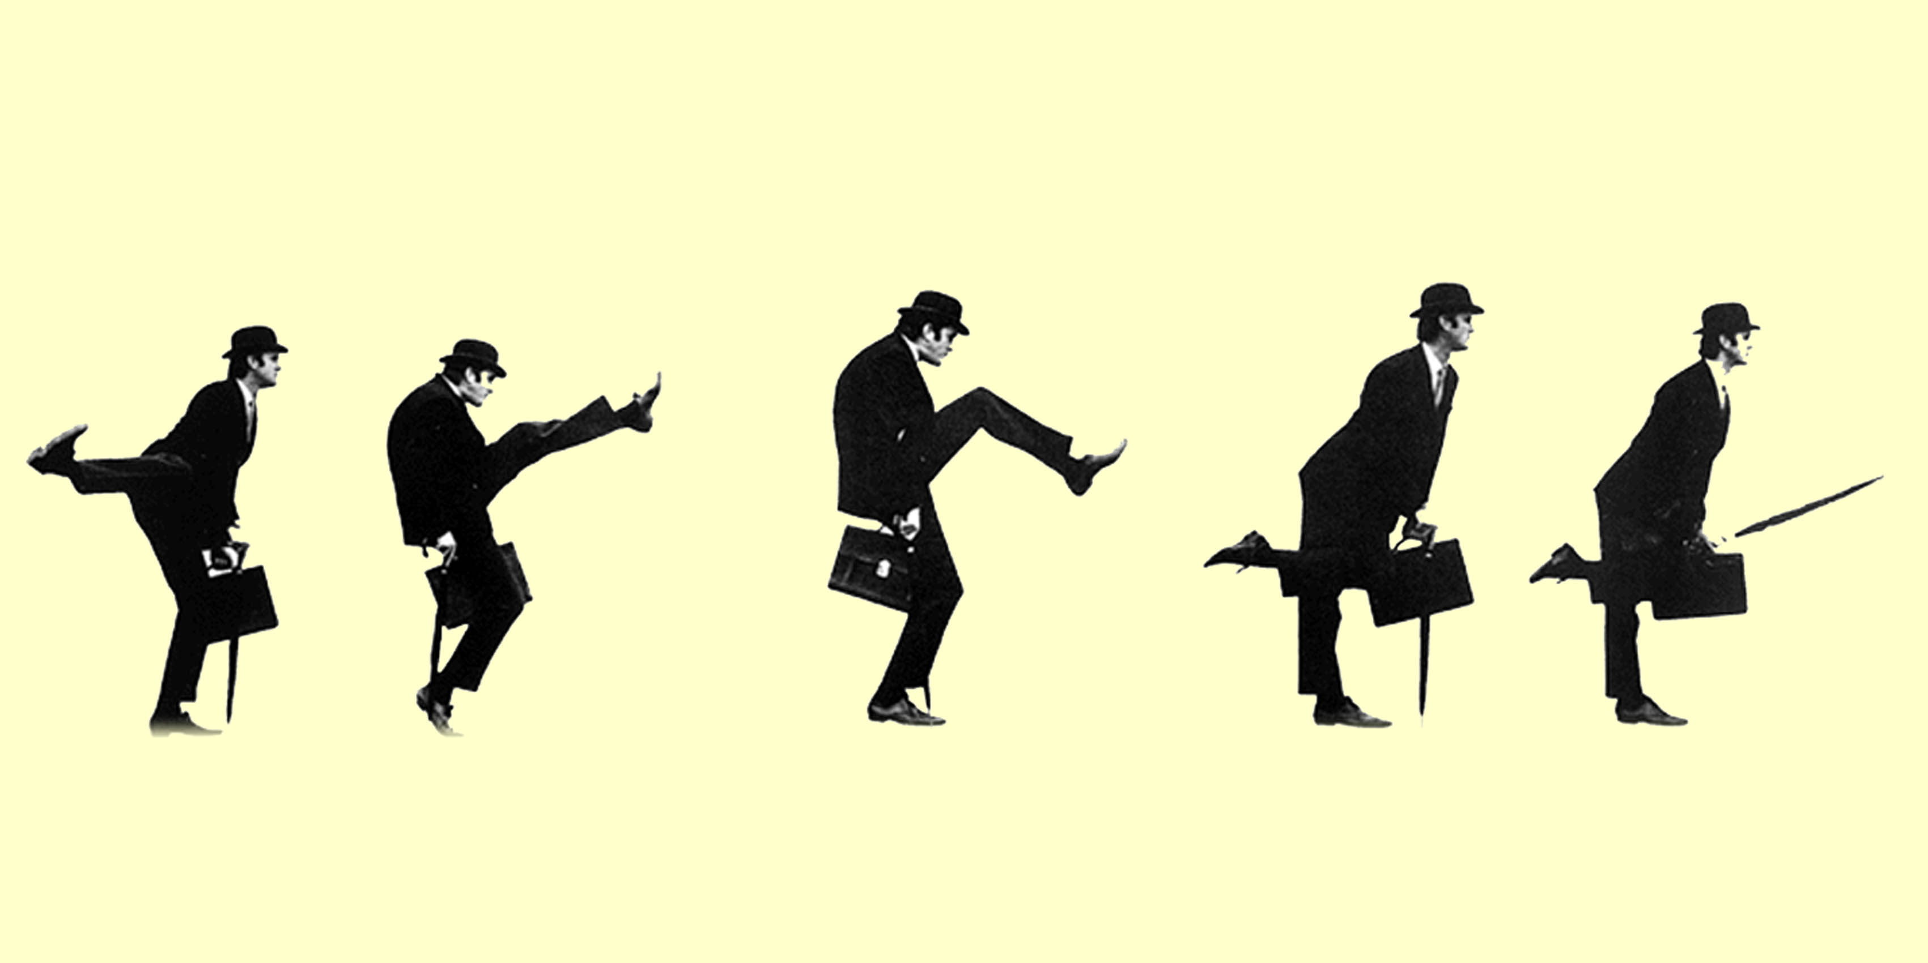
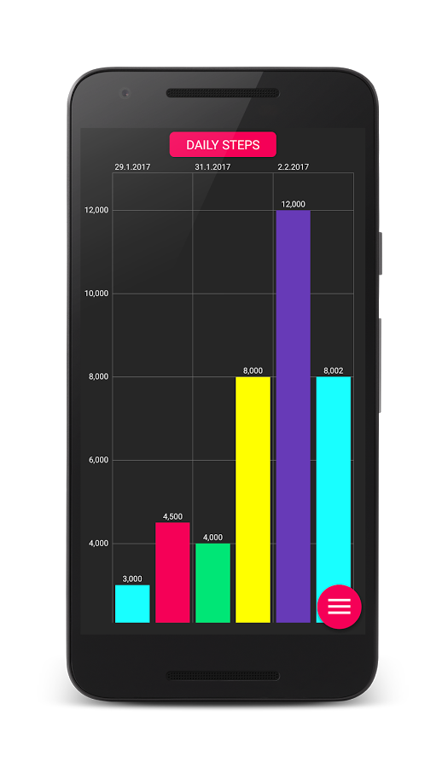
Notes:
-Imagine as part of a study you need to collect step counts
-Give step count trackers to a cohort, these automatically send data to a server
-You complete a cohort with good data, and start a new one
-A week in, your funding gets cut
-Data is in two very disparate chunks
-Data is noisy, could have strong autocorrelations, depression

Slide 4
Estimating Means With Sparse Data
What are our options?
Individual means
Grand mean for everyone
Something else?
Notes:
-This is the problem of estimating parameters with sparse data
-We could use the individual sample means, but that has a lot of noise
-To increase stability we could use the grand mean for everyone’s estimated parameter, but that’s not very satisfying and is also probably far off
-There’s a middle path that was developed by Stein in 1955, and I’d like to thank Dr. Waldman for bringing it to my attention

Slide 5
Blended Mean
Individual sample mean IM
Grand mean GM
“Shrinking” coefficient s
0 ≤ s ≤ 1
“Blended mean” is GM * s + IM * (1 – s)
Notes:
-Stein’s method = using a shrinking coefficient
-How to select s? In the step count model, we can calculate s directly by comparing the complete cohort’s data to what they looked like a week in

Slide 6
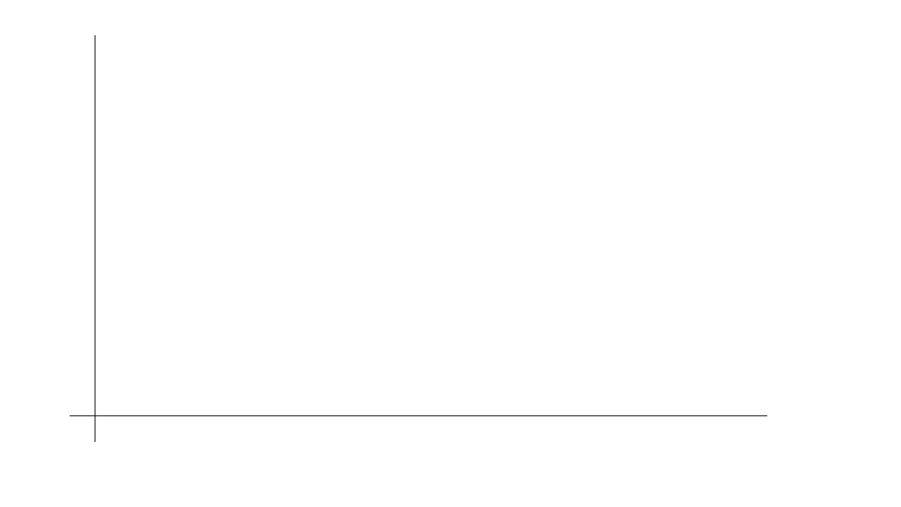
Why does this work?
RMSE
Flexibility of Fit
Notes:
-Orient to graph

Slide 7
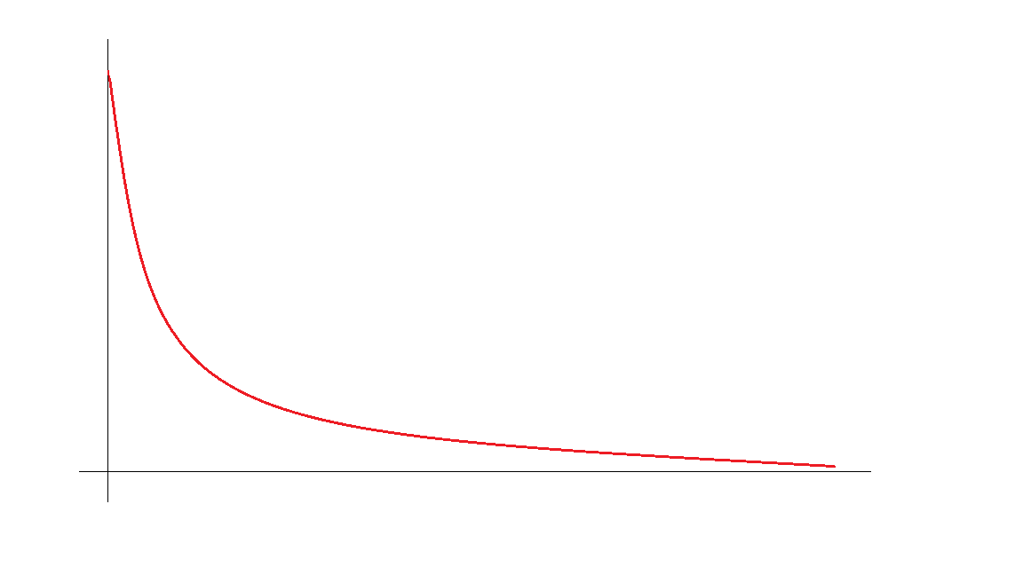
Why does this work?
RMSE
Sample
(Fit)
Flexibility of Fit
Notes:
-For data we use to fit the model, as flexibility increases, the model adheres more closely to the data

Slide 8
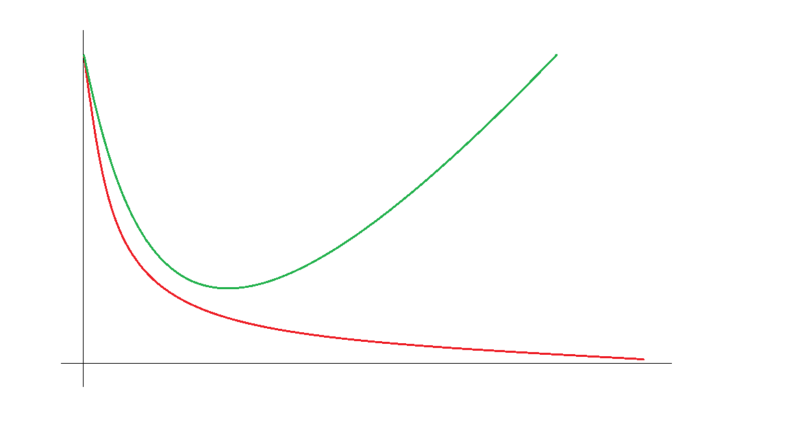
Why does this work?
Population (Prediction)
RSS
Sample
(Fit)
Flexibility of Fit
Notes:
-However the more flexible the model, the more likely it is to chase noise
-There’s a sweet spot
-These curves depend on the size of the fitted data set
-Larger that is, the longer these curves stay close
-FLEXIBILITY CAN BE DANGEROUS

Slide 9
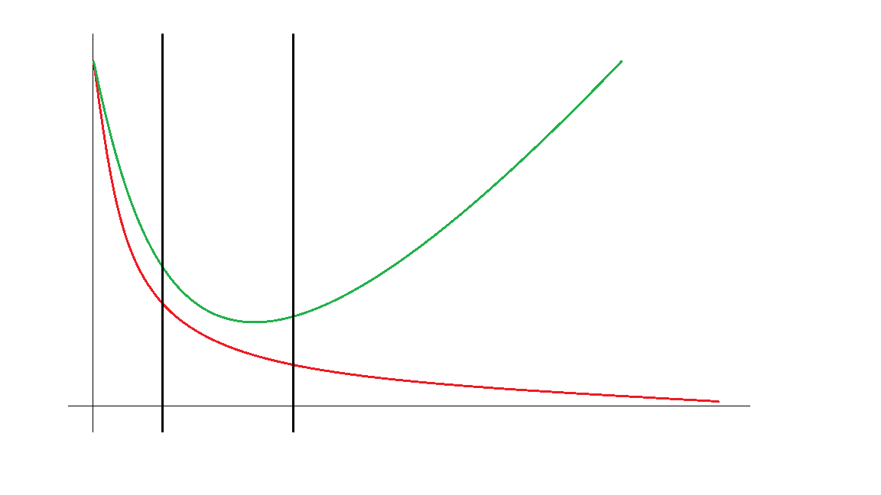
Why does this work?
Population (Prediction)
GM
IM
RMSE
Sample
(Fit)
Flexibility of Fit
Notes:
-Stein showed that for most ordinary cases, the sweet spot lies between the grand mean and individual means as estimators of parameters

Slide 10
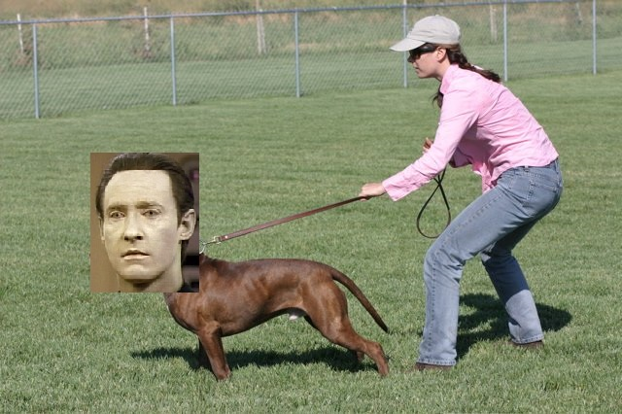
Why does this work?
Notes:
-Like putting a leash on your data so it doesn’t chase squirrels

Slide 11
When does this work?
Mean estimation with multiple participants
Desire to reduce error
True distribution of means is unimodal
Some knowledge of the true distribution exists
Notes:
-What are the conditions under which Stein’s blended estimator is better than individual means?
-3 or more participants
-True distribution is unimodal and has finite variance
-Need some info about true distribution to tune shrinkage parameter

Slide 12
BIG with predictor variables
Weighted regressions instead of weighted means
s is a weight on group data
Individual data has a weight of 1
How to estimate the true distribution?
Notes:
-I adapted this method to multivariate data
-Instead of a weight on means, we use s as a weight on group data, and individual data always has a weight of 1
-Fading in group data for a regression
-Stein’s method requires knowledge of the true distribution to optimize s, but usually we don’t have that
-What we usually have is a finite sample
-If we fit the sample, each data point pulls the model toward that point
-We’d like to use our set to test prediction, but then what do we fit the model on?
-With our finite sample of data, each point somehow needs to be both part of training set to fit the model, and part of the test set without overestimating how well the model is doing

Slide 13
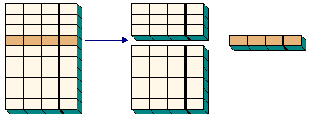
Cross Validation (CV)
Sample
Training Set
Test Set
x₁
x₂
x₃
y
Notes:
-Knock out a small amount of data
-Fit the model on what’s left (this is the training set)
-Test the model on the knocked out portion (this is the test set)
-Repeat this until all data has been tested
-Gives a much better estimate of how well the model does on out of sample data

Slide 14
Can BIG Improve Model Selection?
Hypothesis:
Using BIG fits across multiple models, with s tuned through cross validation, will improve likelihood of picking the true model
Notes:
-We now have a way of extending Stein’s method in the case where we have multivariate data and where we don’t know the true distribution. So what?
-My use for this is model selection.
-We have a bunch of models, we’d like to know which is the best explanation of the data.
-We don’t have much data, so we’d like to improve the power of the model selection process.
-Hypothesis: blended regression estimator tuned through cross validation will improve power of model selection

Slide 15
Data and Models
How do people allocate behavior in the presence of punishment?
Critchfield et al (2003) data set
13 participants
115 data points
8 models of behavior allocation
As described by Klapes, Riley & McDowell (under review)
Notes:
-The question is how do organisms allocate behavior in the presence of simultaneous reward and punishment.
-Best dataset for this comes from Critchfield (2003), but this is not a big data set. Our lab is currently working on ways of getting more data, but for right now this is what we’ve got.
-We have a small dataset and a lot of similar models, we wouldn’t expect the model selection procedure to have much power.

Slide 16
Simulation Experiment
Pick a “true” model
Notes:
-In order to assess how well the method recovers the true model, we would need to know what the true model is. In real life we don’t know – that’s why we’re running the experiment. So, we assume that one of the models is the “true” model.
-What does it mean to be the true model? It means that the distribution of dependent variables is consistent with the equation describing the model. In other words, a “true” model constrains possible dependent variables.

Slide 17
Simulation Experiment
Pick a “true” model
Fit REAL data to “true” model
Use fit parameters to create distributions
Notes:
-The data set constrains it even further. If we assume a model as the source of the data, then we can calculate the most likely distribution of data by doing an OLS regression.

Slide 18
Simulation Experiment
Pick a “true” model
Fit REAL data to “true” model
Use fit parameters to create distributions
Use distributions to generate FAKE data
Notes:
-With a distribution that represents the model, we can now generate an unlimited amount of data sets.

Slide 19
Simulation Experiment
Pick a “true” model
Fit REAL data to “true” model
Use fit parameters to create distributions
Use distributions to generate FAKE data
Fit FAKE data to all models
Notes:
-These data sets can now be regressed to all of the models using both methods – BIG and OLS.

Slide 20
Simulation Experiment
Pick a “true” model
Fit REAL data to “true” model
Use fit parameters to create distributions
Use distributions to generate FAKE data
Fit FAKE data to all models
Assign evidence
Notes:
-We then assign evidence to each of the models depending on how well the data sets fit.

Slide 21

Simulation Experiment
Notes:
-Basically, we’re making clones of the data set with some variation that is consistent with one of the models. We then see which of the two methods is better at identifying which data sets come from which models.

Slide 22
Simulation Experiment
This is a test of the method, not the data or models
We know the truth
Can we match the dataset to the model it came from?
Notes:
-To be clear, this is not a test of the data or the models themselves – it is a test of the method.
-WE KNOW THE TRUTH

Slide 23
Simulation Results
Model recovery power:
OLS: 68.5%
BIG: 73.8%
Small but significant improvement
t(1279) = 4.1, p < .0001
Notes:
-Here are the results.
-OLS has poor power, only 68.5% of the time recovering the true model.
-BIG is slightly better, adding about 5% power to the model selection procedure.
-The difference is small but has a p-value of less than .0001, so I’m convinced it’s a real effect.

Slide 24
Discussion
In this simulation, BIG increased model recovery power by ~5%
Unknown in the general case
BIG is simpler than other methods that contract parameters towards a group mean
However, it requires more sophisticated methods than are commonly used
I can help if you put my name on a publication
Notes:
-Conclusions.
-In this simulation, BIG improved recovery of the correct model by about 5%
-Unknown exactly which conditions will increase model recovery power
-There are other methods that contract parameters toward the mean, like Hierarchical Linear Modeling, but this method is simpler than those, only using weighted regressions
-However, it might still be too much for most people
-If you’re interested in using this method and have questions, I can help for the small price of getting my name on a paper

Slide 25
Thanks
Dr. McDowell
FAC members
Dr. Waldman
Dr. Wolff
Labmates
Olivia Calvin
Ryan Hackett
Bryan Klapes
Cyrus Chi
Notes:
-I’d like to thank Dr. McDowell for really pushing me to simplify this technique and make this talk user-friendly
-I’d also like to thank my FAC advisors (list) and my labmates (list) for good input and discussion of the methods involved

Slide 26
Citations
Critchfield, T. S., Paletz, E. M., MacAleese, K. R., & Newland, M. C. (2003). Punishment in human choice: Direct or competitive suppression?. Journal of the Experimental analysis of Behavior, 80(1), 1-27.
Stein, C. (1955). A necessary and sufficient condition for admissibility. The Annals of Mathematical Statistics, 26(3), 518-522.

